Slide 1
What Do You Do After School?
Book 2 Unit 2

Slide 2
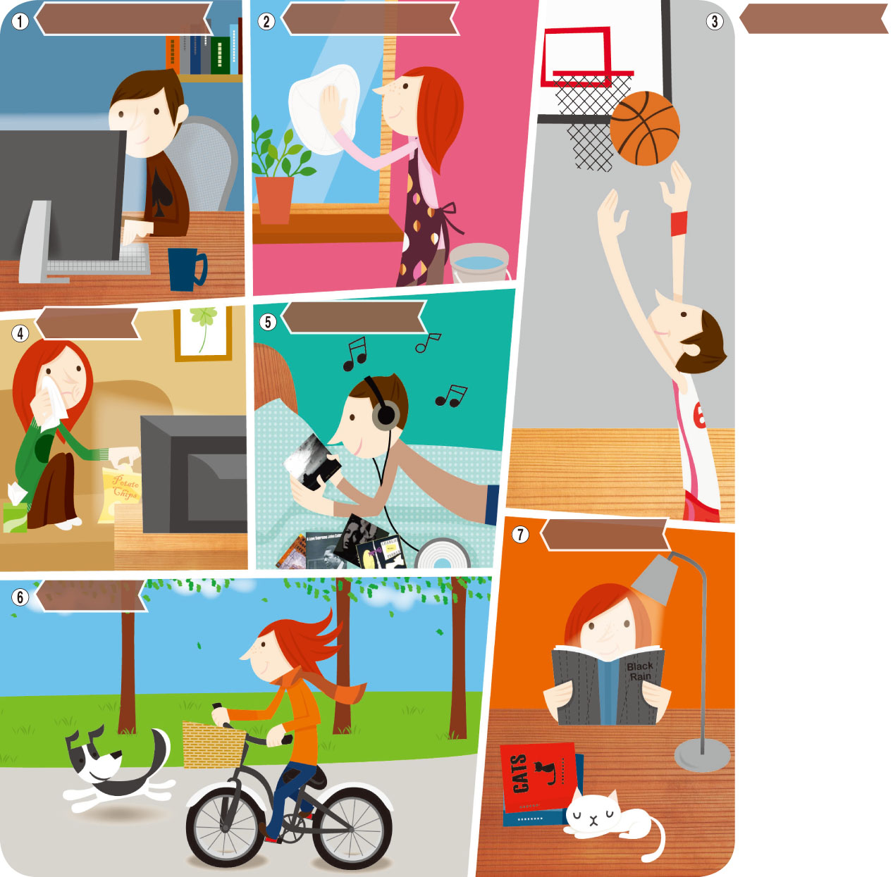
Talk about it.
What do you do after school?
Use the computer
Clean the window
Play basketball
Watch TV
Listen to music
read
Ride a bike

Slide 3
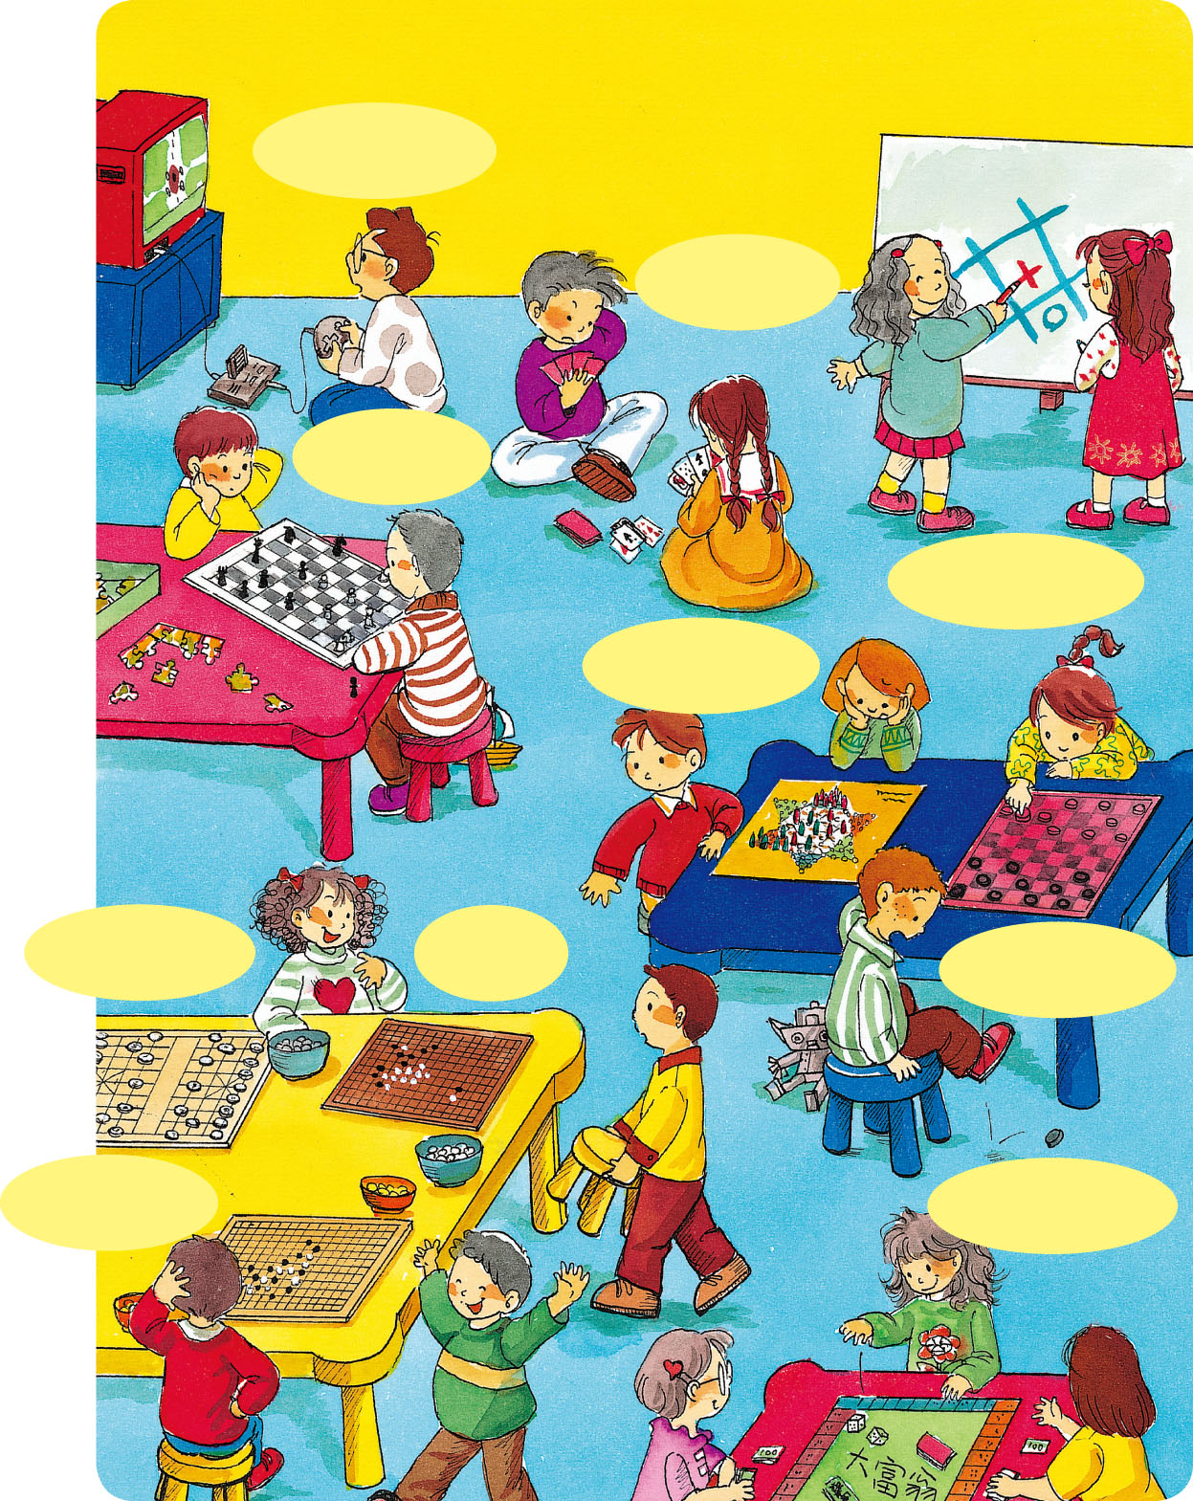
常見的休閒活動
playing video games
Playing cards
Playing chess
Playimg tic-tac-toe
Playing Chinese checkers
Playing Chinese chess
Playing go
Playing checkers
Playing gobang
Playing Monopoly

Slide 4
Pre-reading questions
1 | What do you do during the day?
2 | Do you do your homework before dinner?
3 | Do you go home after school?
4 | What do you do after dinner?

Slide 5
Let’s Read Page 22
READ IT OUT LOUD!

Slide 6
Magic
字義 | 詞性 | 例句
魔法 | 名詞 | Do you believe in magic?（你相信魔法嗎？）
魔力、神奇力量、魅力 |  | Children can't resist（[rI `zIst] 抵抗）the magic of Santa Claus. （小孩子無法抗拒聖誕老人的魔力。）
魔術戲法 |  | The book explains how to do magic. （這本書說明如何變魔術。）
魔法的、神奇的 | 形容詞 | The Little Mermaid became a real girl after she drank the magic potion. （小美人魚在喝下魔法藥水後，變成一個真正的女孩。）
魔術的 |  | He can do a lot of magic tricks. （他會變很多魔術戲法。）

Slide 7
During (prep.)
用以表「開始到結束這段時間」
（from the beginning to the end of a period of time）
後須接名詞
如during the summer / afternoon / night
例He stays at home every day during the summer.（他夏天時每天都待在家裡。）

Slide 8
Before(prep.)
後須接名詞
例Let's meet at our house before the show. （表演開始前先在家裡集合吧！）

Slide 9
Put on
動詞片語
例Put on your jacket. It's getting cold.
（穿上你的外套。天氣漸漸變冷了。）
put on強調「正要穿上衣服」的動作，而wear 表示「穿著…」的樣子
例He likes to wear blue jeans.（他喜歡穿牛仔褲。）。

Slide 10
Put on
相反詞take off
例 I don't want to take off my coat because it's really cold in the office today.
（我不想脫掉我的外套，因為今天辦公室裡好冷。）

Slide 11
After-reading questions
1 | What is the Magic Girl's name?
2 | What does Audrey do during the day?
3 | When does Audrey do her homework?
4 | What happens to some kids if they don't go home after school?
5 | Do you think Audrey’s parents like her work?

Slide 12
summary
Audrey Jones is the hero from Ted's book. In Ted's story, she goes to school during the day and does her homework before dinner. After dinner, Audrey changes into Magic Girl to help kids who get into trouble.

Slide 13
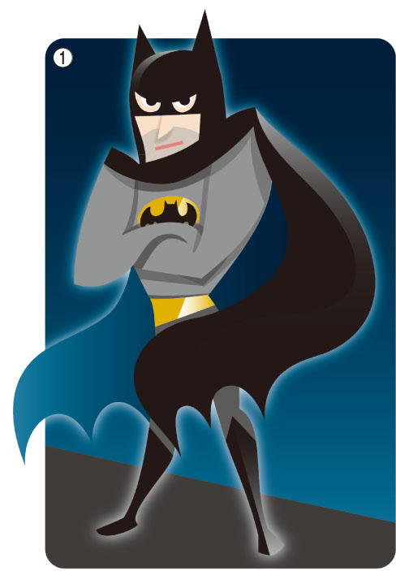
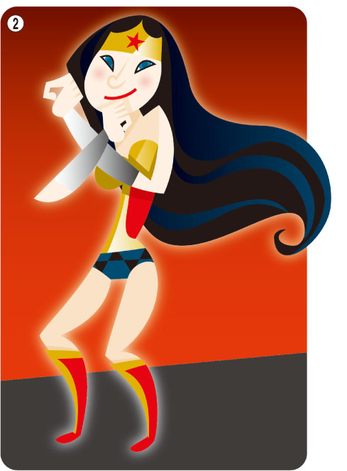
Superheroes
Look at these superheroes. Who are they?
I am Batman.
I wear a mask
and a cape.
I am Wonder Woman.
I have bulletproof bracelets.

Slide 14
DC漫畫和Marvel漫畫
DC and Marvel are two traditional comic companies.
DC----Justice League(JLA)
Marvel----Avengers

Slide 15
DC |  | Marvel
超人 | Superman | 鋼鐵人 | Iron Man
蝙蝠俠 | Batman | 浩克 | the Hulk
神力女超人 | Wonder Woman | 美國隊長 | Captain America
閃電俠 | the Flash | 蜘蛛人 | Spiderman
綠光戰警 | Green Lantern | 金鋼狼 | Wolverine
貓女 | Cat Woman | 雷神索爾 | Thor

Slide 16
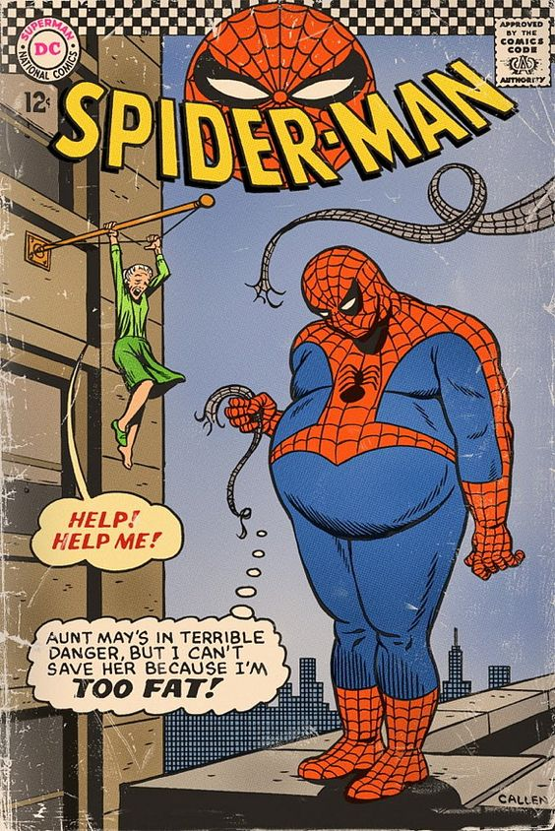
Let’s read some comics

Slide 17
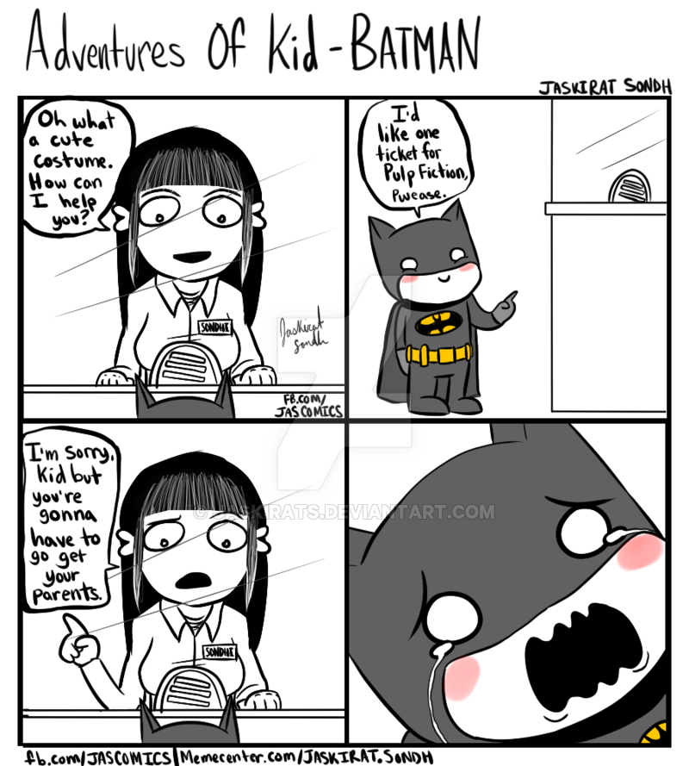
Let’s read some comics!

Slide 18
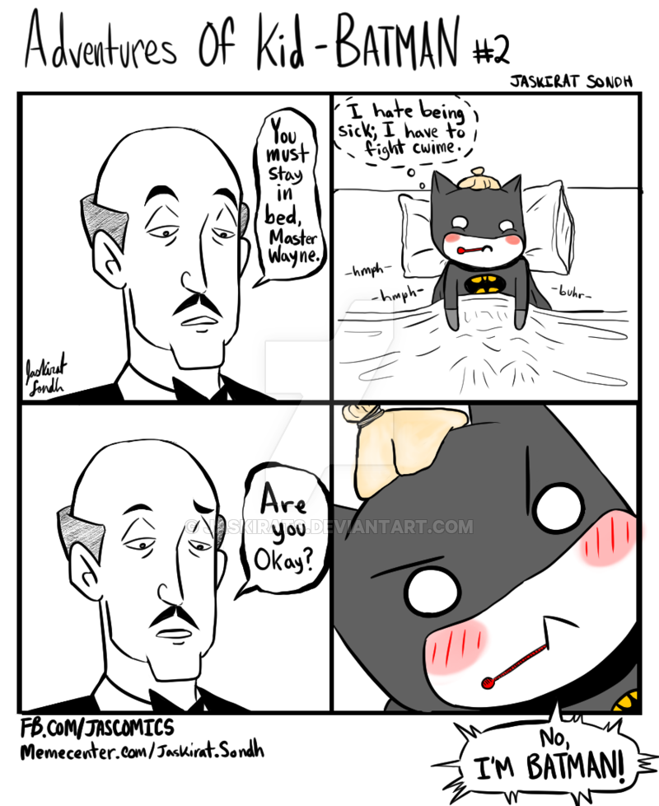
Let’s read some comics

Slide 19
Now, it’s your turn!

